Slide 1

Safe City
Preventing Crime and Promoting Safe City Through AI
Team 9: Jennifer Siwu Shujiang Tan Henry Dang Sushrut Shendre Junxiu Wang

Slide 2

Introduction
Inspiration We hear stories about crimes happening in big cities everyday. Often times, we only found out about it after it happened.
Our Solution A proactive measure using Deep Learning and AI algorithm to empower police officers in preventing crime and city pedestrians in self-protection. Focusing on Boston.
How it Works Targeting two main users: 1. Crime Type prediction for police officers. 2. Crime Safe walkable path (GPS) for city pedestrians.

Slide 3
Project Overview
Step 1
Step 2
Step 3
Step 4
EDA & Insight Generation
Model and Algorithm Building
Result Generation
Data Collection and Cleaning
Boston crime incident dataset from the official Boston Government website and Boston Shapefile from arcgis.
Exploratory Data Analysis to generate pattern or trends that we will use for our model and our short path algorithm.
Conducted feature engineering based on the EDA result. Built multiple Artificial Neural Network models with Keras and Tensorflow. Leveraged Dijkstra Algorithm for the Walking Path Generation.
Model Validation and performance assessment. Crime-safe short path output.

Slide 4
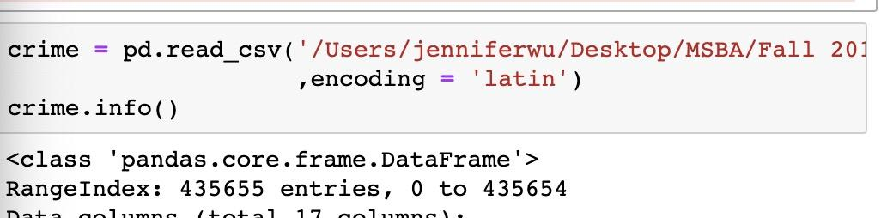
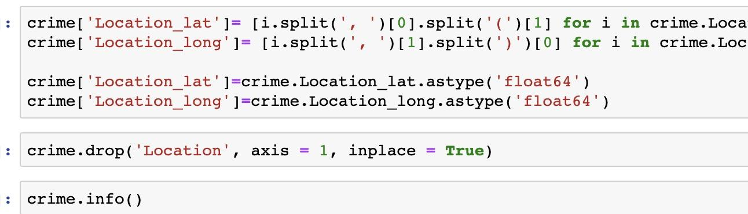
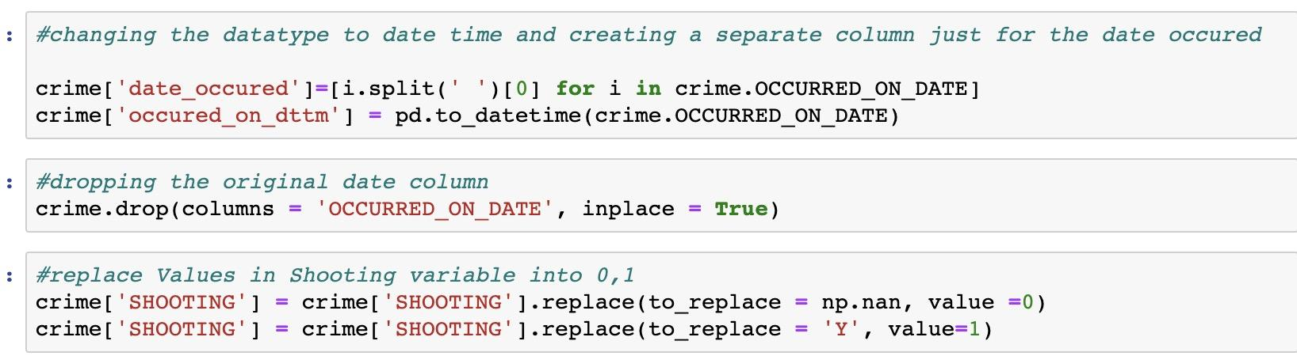
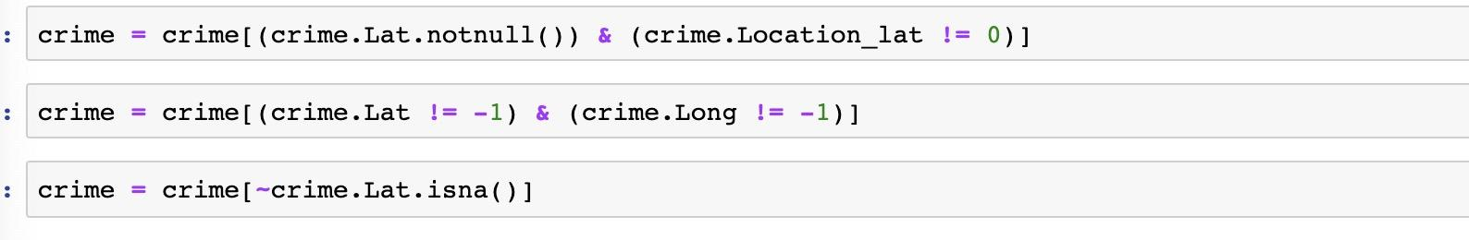
Data Collection Part 1
Get data from Boston Gov: https://data.boston.gov/dataset/crime-incident-reports-august-2015-to-date-source-new-system
Clean the data
Download as CSV and read data in Python
Removing Null/NAN

Slide 5
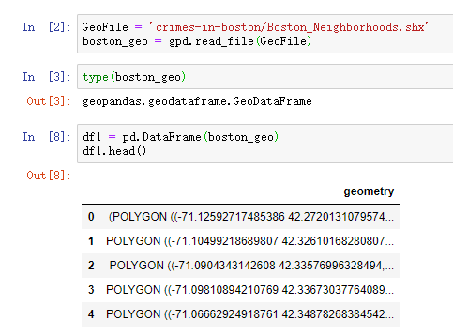
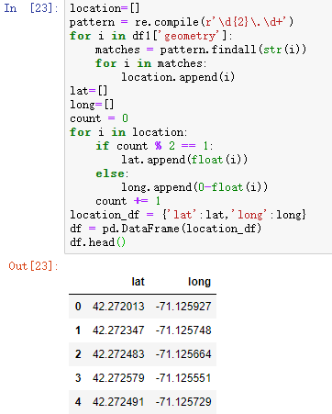
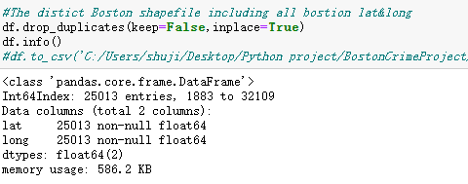
Data Collection Part 2
Get Boston Geopandas Shapefile from Boston Opendata: https://bostonopendata-boston.opendata.arcgis.com/datasets/3525b0ee6e6b427f9aab5d0a1d0a1a28_0
Import Shapefile Extract Lat & Long Remove duplicates

Slide 6
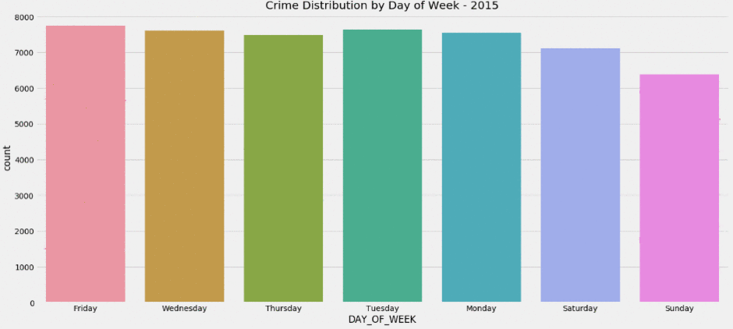
Insight: Crime Distribution by Day of Week

Slide 7
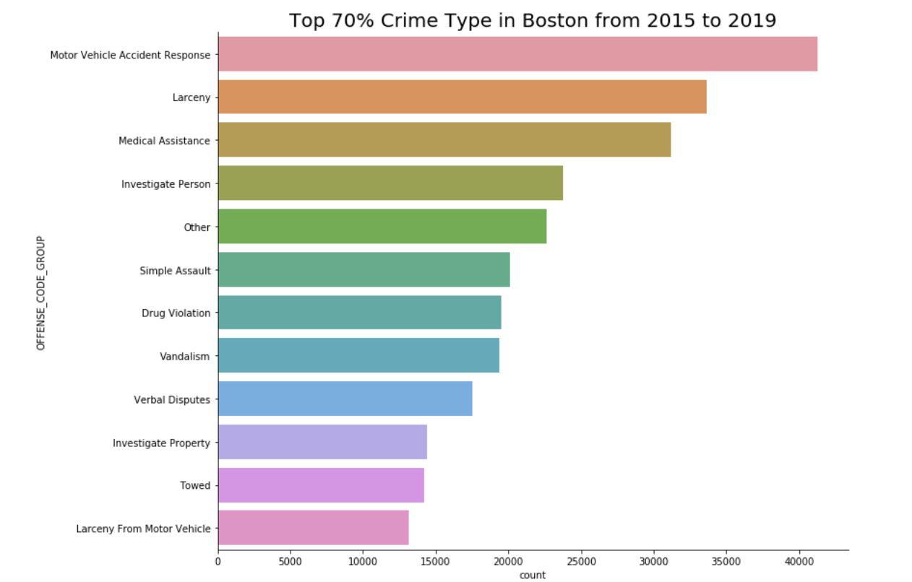
Insight: Top 70% Crime Type in Boston

Slide 8
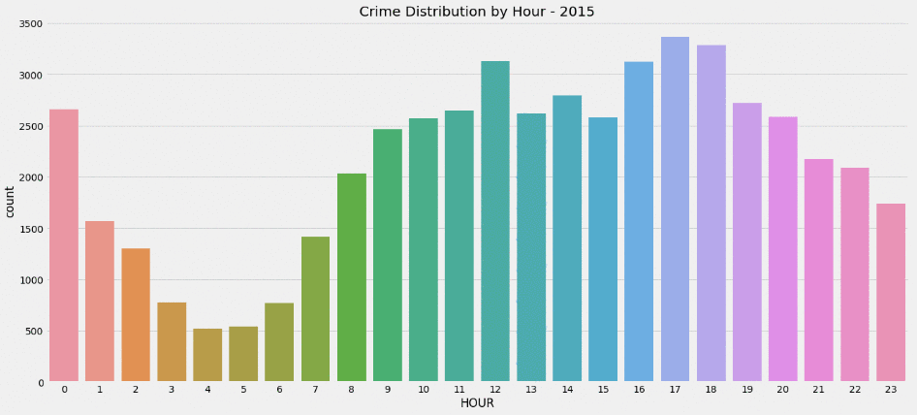
Insight: Crime Distribution by Hour

Slide 9
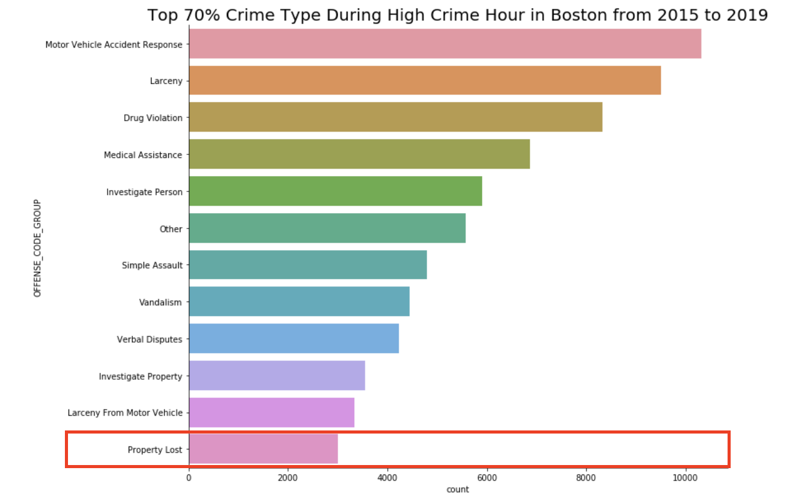
Insight: Top 70% Crime Type During Crime Hour

Slide 10
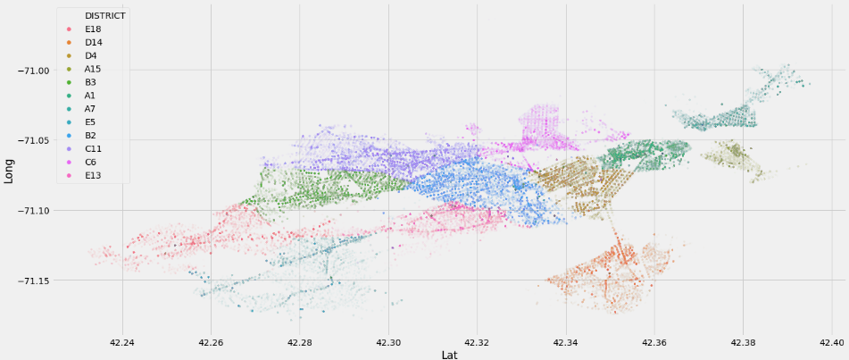
Insight: Crime Concentration by District
Notes:
We’re able to see that there is a higher concentration of crime happening within Boston in the East than the West.

Slide 11
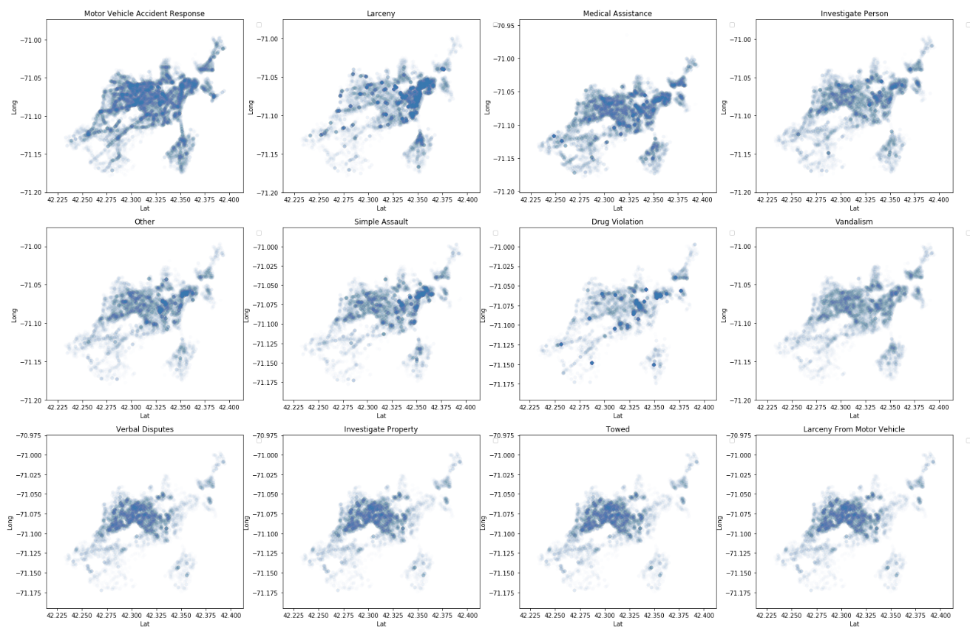
Insight: Top 70% Crime Type Density Plot

Slide 12
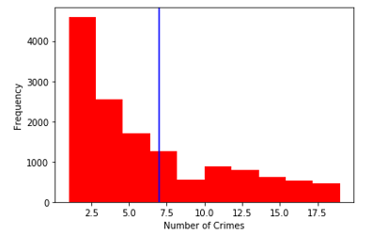
Insight: Number of Crimes Per Location
Median: 7
Notes:
Grouping the crime by the lat & lat
All throughout 5 years the median of the number of crime is 7.
Median: 7 number of crimes (more than half of the crime happens)
This will be used in our algorithm that my peer will talk about later

Slide 13
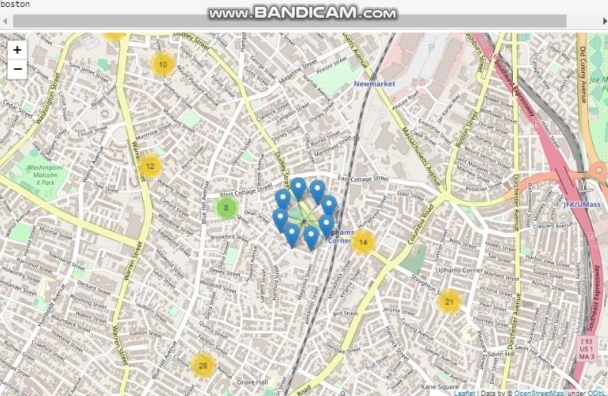
Insight: Boston Crime Mapping (Folium)
Crime Frequency in Boston Visualization Demo

Slide 14
Model Building : Predicting Crime Type
Police Authority
TARGET USER
PREDICTION TYPE
Multiclass Classification using ANN in Keras and Tensorflow
OUTLIER TREATMENT
Limiting the predicted output to Top 70% crime type
Crime Type (Offense_Code_Group)
DEPENDENT VARIABLE
FEATURE ENGINEERING & DIMENSION REDUCTION
Grouping Top 10% high-crime address variable and create season variable
Correlation Matrix and Chi-Squared test
Used backward method
Notes:
The main target user of the model is police authority.
They will use the output to assess their strategies in preventing those crimes from happening.
The prediction type will be multiclass, and to remove outliers, we decided to keep only top 70% most frequent crime code to train the model on.
That resulted in 12 different crime types or offense code.

Slide 15
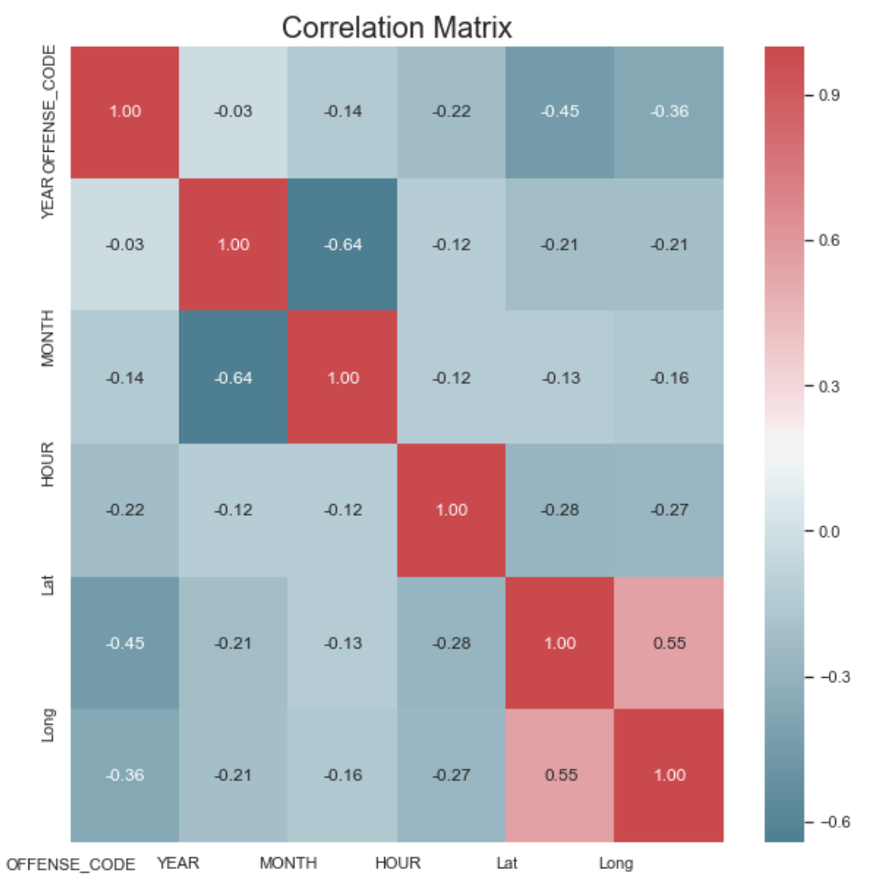
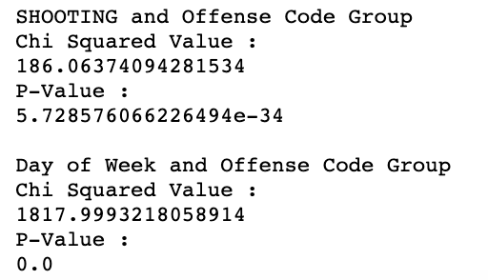
Outlier Treatment, Feature Engineering, and Dimension Reduction
Correlation Matrix
Chi-Squared Test
Notes:
The shooting var tells us if there is a shooting or not during the crime. Because its impossible to get this data before the crime happens, we decided to remove this variable from our model

Slide 16
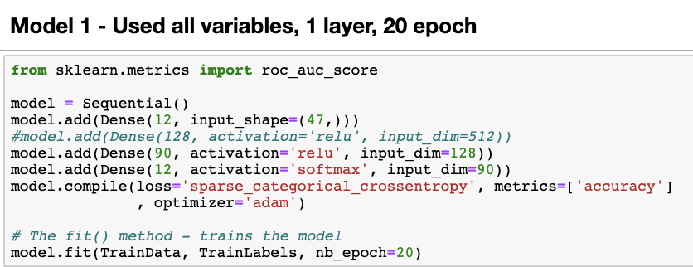
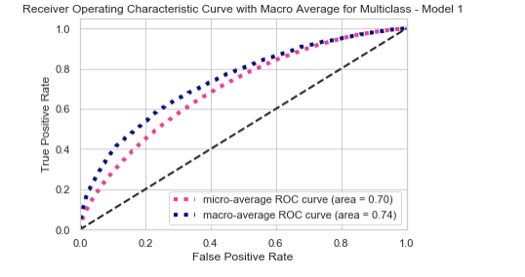
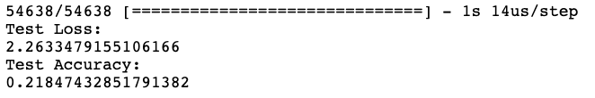
Model 1
Training the Model
ROC and AUC
Evaluating the Model with Test Data

Slide 17
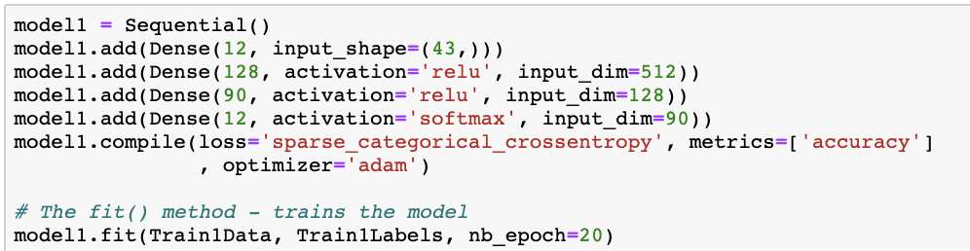
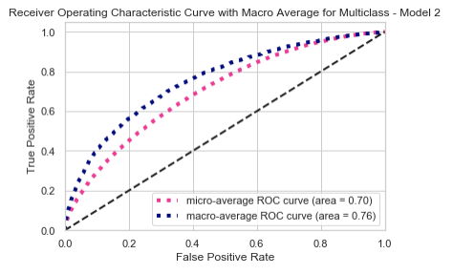
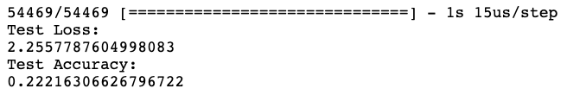
Model 2
Training the Model
ROC and AUC
Evaluating the Model with Test Data
Notes:
Besides doing these 2 models, we also tried running binary classification predicting one crime type vs others at a time which resulted in a higher accuracy. However, we came back to our objective to prevent the most frequent crimes. Therefore, a crime is a crime and it’s not that one crime is more important than others. Since different crime may require different strategies to prevent, we came back to this multiclass classification model and that being said We decided to use model 2.

Slide 18
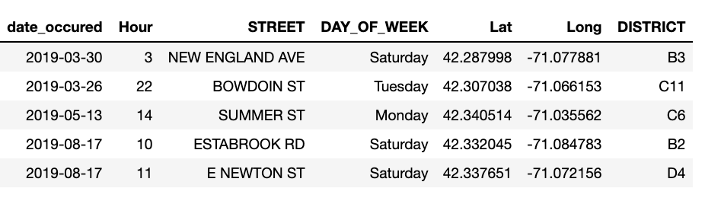
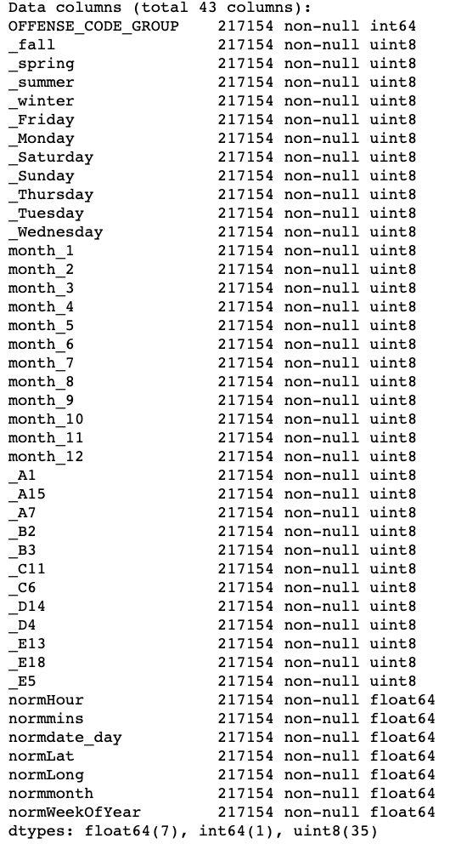
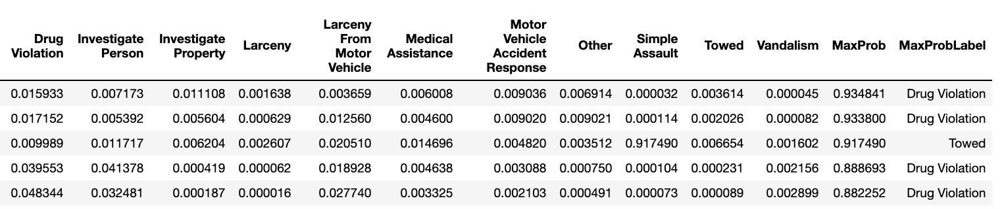
Model Input and Output
1 : Data is collected in the below format
2 : Alter it to below format for the model
3 : Model exports the prediction in below format
Notes:
Created these 2 columns to show the highest probability crime

Slide 19
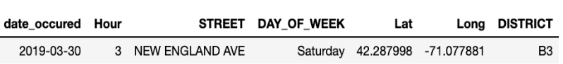
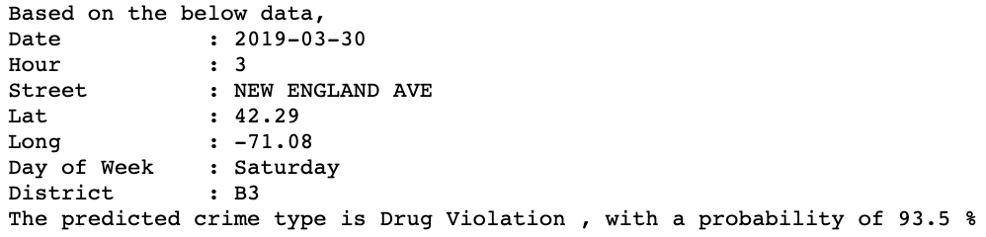
Prediction Output Format For Users
Notes:
And finally, this the format of the output that we will provide to our users.

Slide 20
Safe Walkable Path Algorithm
City Pedestrians/Walkers
Target User
Dijkstra Shortest Path Algorithm
Algorithm
Based on EDA result, any location with more than 7 crime incidents are considered high crime area
Filter out high crime Lat & Long and using Haversine, remove Lat & Long within 0.5 mile radius of the high crime area
Determining Safe Walking Points

Slide 21
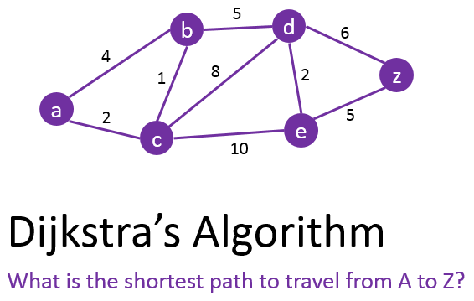

Dijkstra’s Algorithm - Shortest Path
Conceived by computer scientist Edsger W. Dijkstra in 1956
Based on graph theory (given nodes and edges)
Dijkstra's algorithm offer the shortest path between two given nodes

Slide 22
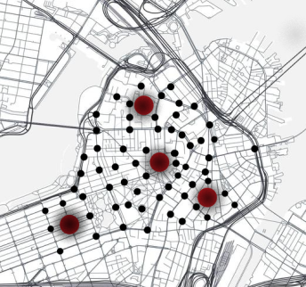
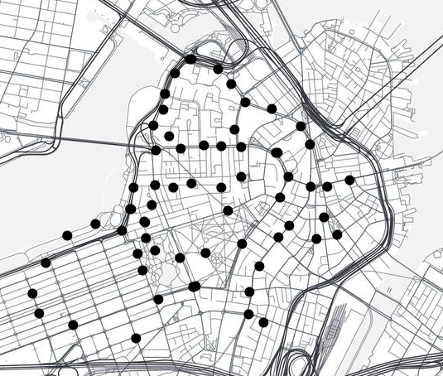
Dijkstra’s Algorithm - How to Get Nodes?
Combine Boston map and high crime data
Nodes generation for Dijkstra
Parent dataset Boston shapefile: consisting of 25013 pairs of lat & long
Filter out high crime lat & long from crime dataset (59 pairs) from parent dataset
For each high crime location, filter out any nearby lat & long within 0.5 mile radius
Each current node represents a location where they are more than 0.5 miles away from high crime area (areas with at least 7 crime incidents over the past 4 years)

Slide 23
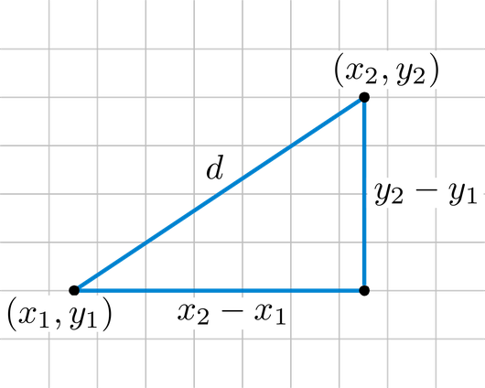
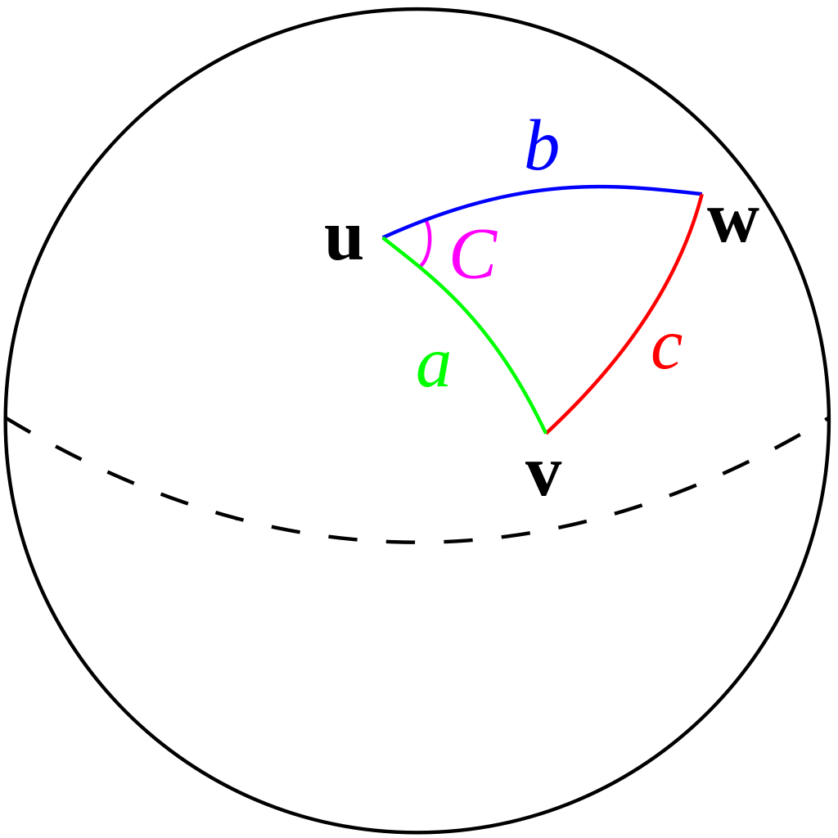
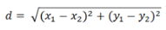
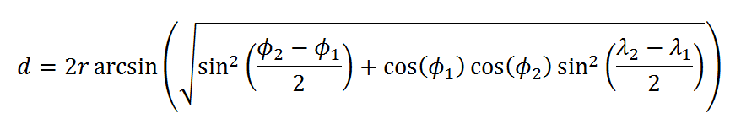
Dijkstra’s Algorithm - How to Get Distance?
Euclidean Distance
Haversine formula
The "ordinary" straight-line distance between two points in Euclidean space
Fails to run on Lat & Long due to sphere circle!
Determines the great-circle distance between two points on a sphere given lat &long
Works perfectly to run on Lat & Long

Slide 24
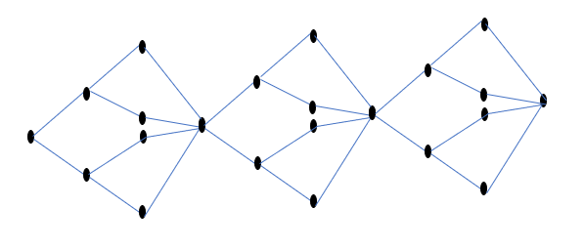
Graph Generation
Attempt 1
Create a 20,000 * 20,000 graph connecting all walkable points in the city.
Discard due to computational power requirements : 50+ hours
Attempt 2
From each point, find three closest points.
Faced issues with the overall connectivity of the graph
Attempt 3: Random Connected Graph Generation

Slide 25
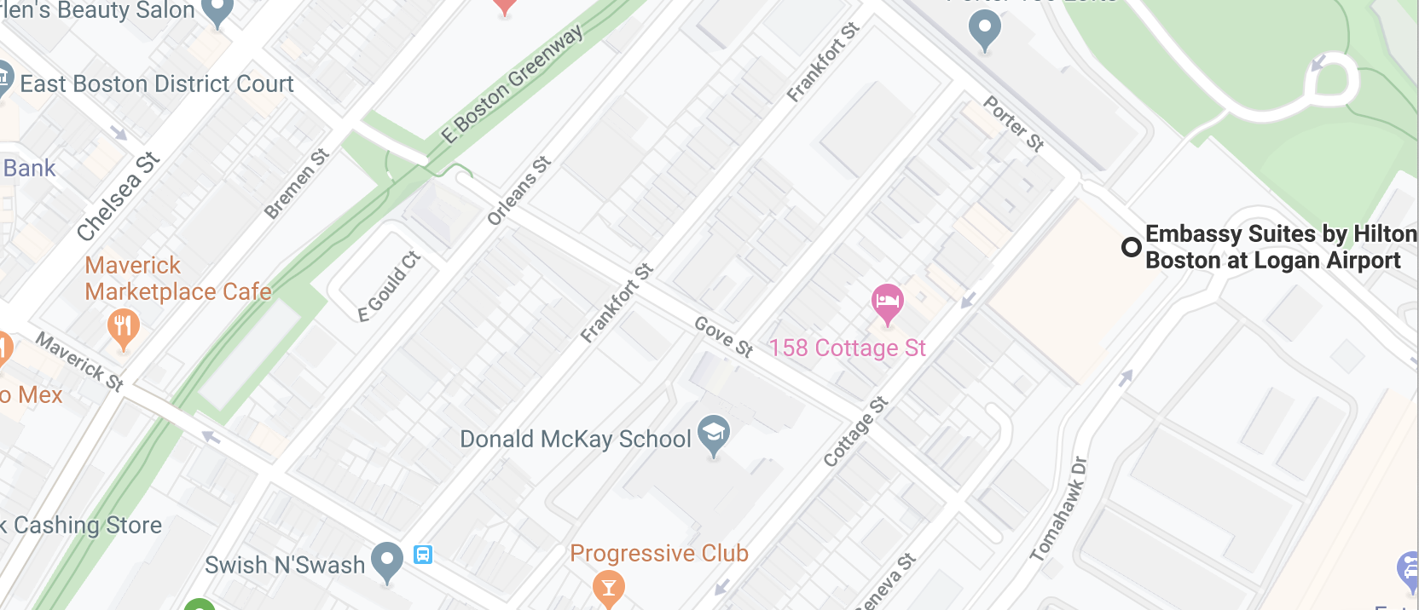
Case Scenario
Eric has landed in Boston and is staying at Embassy Suites at the Hilton.
It’s evening and he wants to explore the Maverick Marketplace Cafe.

Slide 26
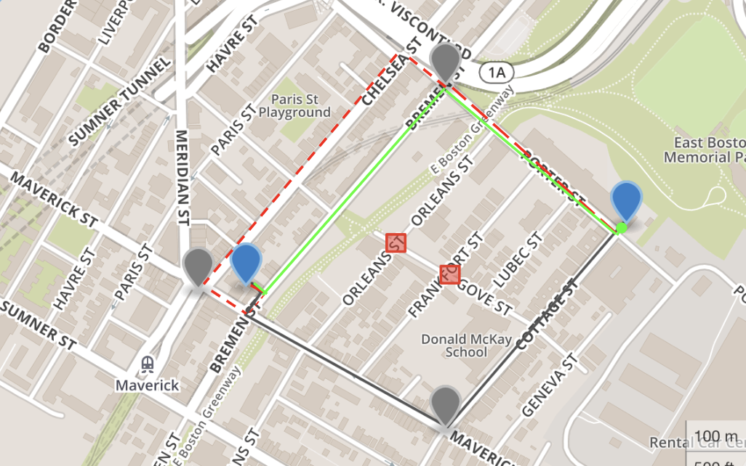
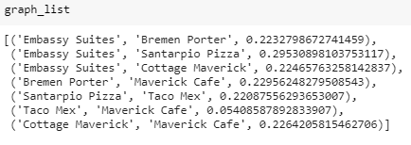
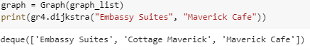
How Our Product Works
Demo: https://gist.github.com/jsiwu94/a84ba9728a3accb2c6ad3a1f0fb95e0a

Slide 27
Conclusion & Takeaways
Police Officers:
Predict a certain crime type that will happen based on a given time, day of the week, and location.
The output will be the offense code group and the probability of it happening.
Police authority can utilize this information to strategically lay out their preventative plans to avoid the crime from happening.
Boston Pedestrian:
Provide the safest and closest distance route for walkers in Boston though analyzing the historical crime data in Boston.
The output of our analysis be a path direction GPS that provides the safest and shortest route or any given starting and ending point provided by the user.
To learn more about our project: https://github.com/jsiwu94/BostonCrimeProject

